Slide 1
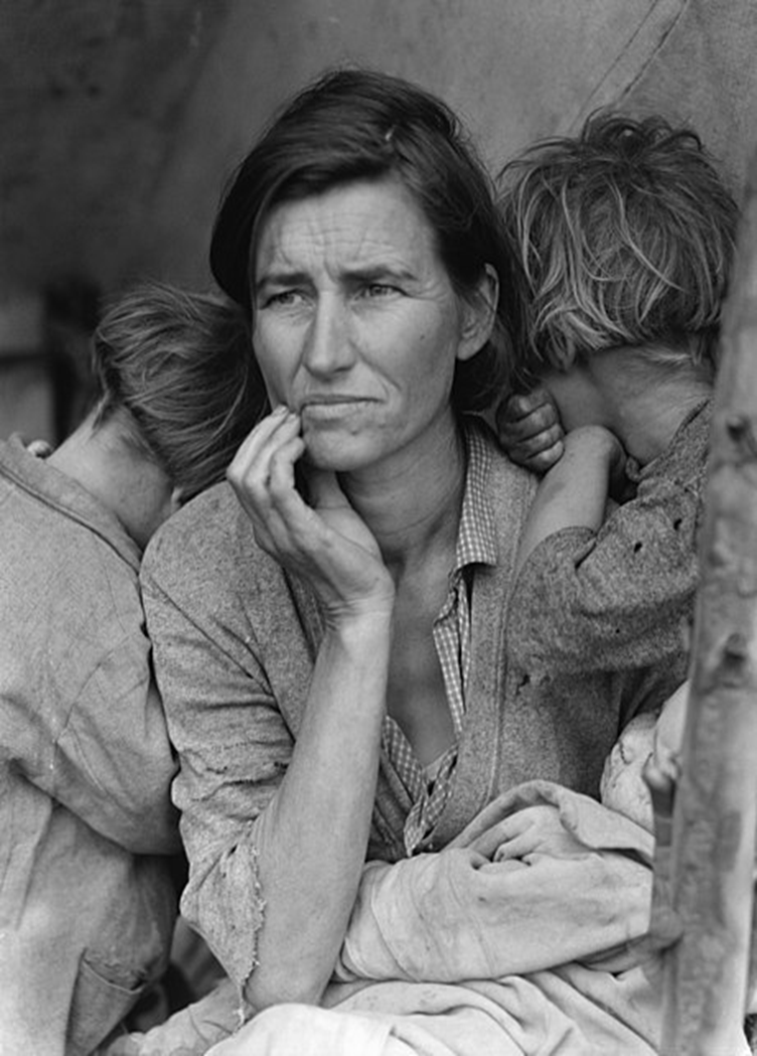
Take a moment and study this photograph carefully. List as many observations as you can about what you see. Think about possible emotions and circumstances conveyed in this picture.
https://www.youtube.com/watch?v=n-rBhbkvtm0

Slide 2
Formation of Soil
Bedrock is ________. As time passes, processes of __________ (wind, water, ice, plants, and temperature changes) break rock into smaller pieces.
Weathering (and other processes) breaks rock into __________ __________. Eventually, bacteria, molds, and fungi produce __________ that break small pieces of rock into tiny particles of soil.
Small __________ begin to grow in the newly formed soil. When __________ plants fall to the ground, __________ and __________ break down the organic matter (__________) and later become part of the soil.
Animals and insects also __________, __________, and become part of the soil as well. As this process continues, the soil layers (__________) continue to develop.

Slide 3
Formation of Soil
Bedrock is exposed. As time passes, processes of weathering (wind, water, ice, plants, and temperature changes) break rock into smaller pieces.
Weathering (and other processes) breaks rock into smaller pieces. Eventually, bacteria, molds, and fungi produce acids that break small pieces of rock into tiny particles of soil.
Small plants begin to grow in the newly formed soil. When dying plants fall to the ground, bacteria and fungi break down the organic matter (decomposition) and later become part of the soil.
Animals and insects also die, decompose, and become part of the soil as well. As this process continues, the soil layers (horizons) continue to develop.

Slide 4
5 Factors that Affect Soil Formation:
CL –
O –
R –
P –
T -

Slide 5
5 Factors that Affect Soil Formation:
CL – Climate (temperate is best, tropical is thickest but worst)
O –
R –
P –
T -

Slide 6
5 Factors that Affect Soil Formation:
CL – Climate (temperate is best, tropical is thickest but worst)
O – Organisms (plants and burrowing animals)
R –
P –
T -

Slide 7
5 Factors that Affect Soil Formation:
CL – Climate (temperate is best, tropical is thickest but worst)
O – Organisms (plants and burrowing animals)
R – Relief (topography – shape of the land) Mountainous areas have thin to no soil; valleys have thicker soils
P –
T -

Slide 8
5 Factors that Affect Soil Formation:
CL – Climate (temperate is best, tropical is thickest but worst)
O – Organisms (plants and burrowing animals)
R – Relief (topography – shape of the land) Mountainous areas have thin to no soil; valleys have thicker soils
P – Parent Material (rock from which soil is made)
T -

Slide 9
5 Factors that Affect Soil Formation:
CL – Climate (temperate is best, tropical is thickest but worst)
O – Organisms (plants and burrowing animals)
R – Relief (topography – shape of the land) Mountainous areas have thin to no soil; valleys have thicker soils
P – Parent Material (rock from which soil is made)
T – Time (100 – 1000 years for 1cm of soil to form) tropical take the least time, deserts take the most time

Slide 10
Soil Profile (Horizons)

