Slide 1
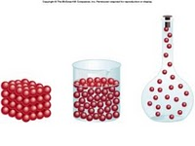
Mass, Volume, & Density

Slide 2
Short Informational Videos
Mass
Volume & Density
Buoyancy

Slide 3
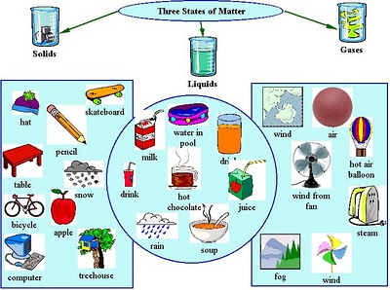
Mass
Measurement of the amount of matter
(or stuff) in an object
  Measured in grams (g)
There are 3 states of matter:
Solid
Liquid
Gas
There are 3 states of matter:
Solid
Liquid
Gas

Slide 4
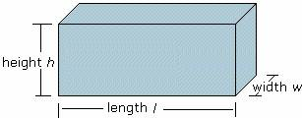
Volume
Measurement of the amount of space an object takes up
  Measured in milliliters (ml) or cm³

Slide 5
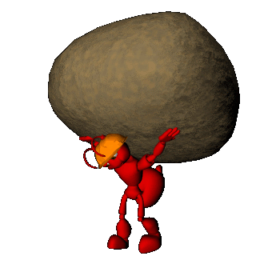
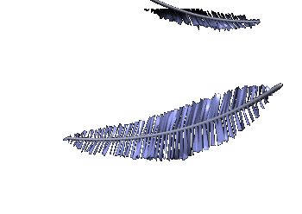
Which do you think would have the greater volume? The greater mass?
Why?
1 kg of rocks
1 kg of feathers

Slide 6
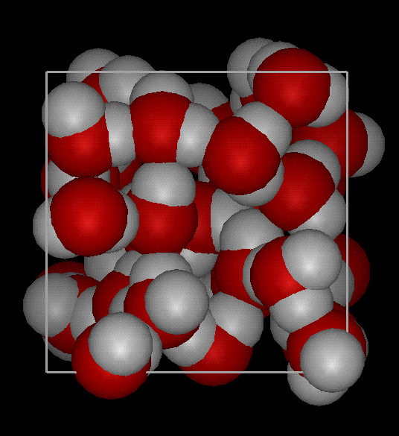
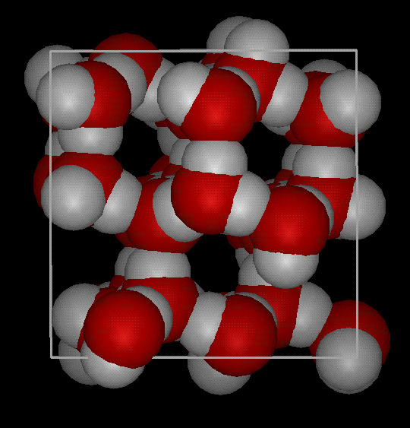
Density
Density is defined as mass per unit volume. It is a measure of how tightly packed and how heavy the molecules are in an object. Density is the amount of matter within a certain volume.
Notes:
Density is the amount of matter within a certain volume.

Slide 7
Which one is more dense?
Demonstration: People in a square
How about this: Which square is more dense?

Slide 8
Which one is more dense?
Now which one is more dense?

Slide 9
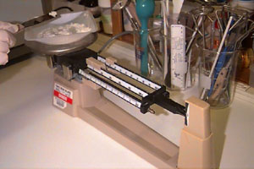
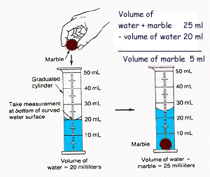
To find the density
1- Find the mass of the object
1- Find the mass of the object
2- Find the volume of the object
3- Divide
Density = Mass g
Volume c³
ALWAYS REMEMBER UNITS!

Slide 10

Change Mass AND Keep Volume Same
Ways to Affect Density
Increase the mass → increase density
Decrease the mass → decrease in density
Which container has more density?
A B

Slide 11
Change Volume AND Keep Mass Same
Ways to Affect Density
Increase the volume → decrease density
Decrease the volume → increase density
Which container has more density?
A B

Slide 12
In your notebook illustrate the answer to the following question:
What 2 ways will INCREASE density?

Slide 13
What 2 ways will INCREASE density?
Keep the same mass AND decrease the volume
Keep the same volume AND increase the mass

Slide 14


Let’s try some density problems together
Work on these problems with your neighbor
1 Frank has a paper clip. It has a mass of 9g and a volume of 3cm³. What is its density?
2. Frank also has an eraser. It has a mass of 3g, and a volume of 1cm³. What is its density?
3. Jack has a rock. The rock has a mass of 6g and a volume of 3cm³. What is the density of the rock?
4. Jill has a gel pen. The gel pen has a mass of 8g and a volume of 2cm³. What is the density of the rock?

Slide 15
Liquid Layers
If you pour together liquids that don’t mix and have different densities, they will form liquid layers.
The liquid with the highest density will be on the bottom.
The liquid with the lowest density will be on the top.
Objects or substances with MORE density will sink below objects or substances with LESS density
  Which do you think is MORE dense,
  Water or Oil???

Slide 16
The density of five liquids are measured as follows:
  Liquid 1: 1.0 g/mL
  Liquid 2: 1.38 g/mL
  Liquid 3: 0.77 g/mL
  Liquid 4: 2.95 g/mL
  Liquid 5: 0.056 g/mL
Draw a picture of all 5 liquids in a test tube how they would layer according to density
Liquid 5
Liquid 3
Liquid 1
Liquid 2
Liquid 4

Slide 17

To find density:
Find the mass of the object
Find the volume of the object
Divide : Density = Mass - Volume
Ex. If the mass of an object is 35 grams and it takes up 7 cm³ of space, calculate the density.

Slide 18
To find density:
Find the mass of the object
Find the volume of the object
Divide : Density = Mass - Volume
Ex. If the mass of an object is 35 grams and it takes up 7 cm³ of space, calculate the density
Set up your density problems like this:
Given: Mass = 35 grams Unknown: Density (g/ cm³) Volume = 7 cm³
Formula: D = M / V
Solution: D = 35g/7 cm3
D = 5 g/cm3

Slide 19
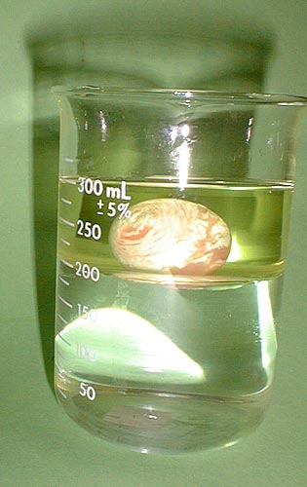
Water, Oil…and a Superball
The oil is less dense than the water, so it’s on top. The superball is less dense than water, but more dense than oil, so it sinks to the bottom of the oil layer, yet floats on the top of the water layer.

Slide 20
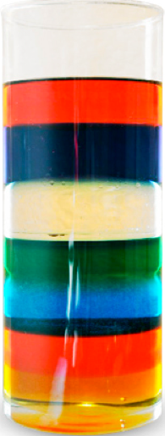
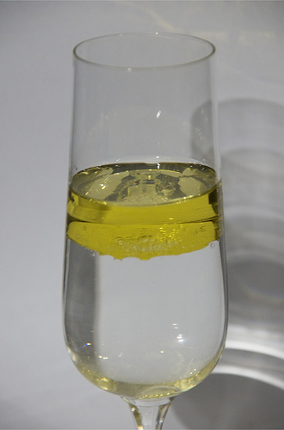
If you have 2 or more substances,
  the MORE dense substance will be on bottom
  The LESS dense substance will be on top

Slide 21
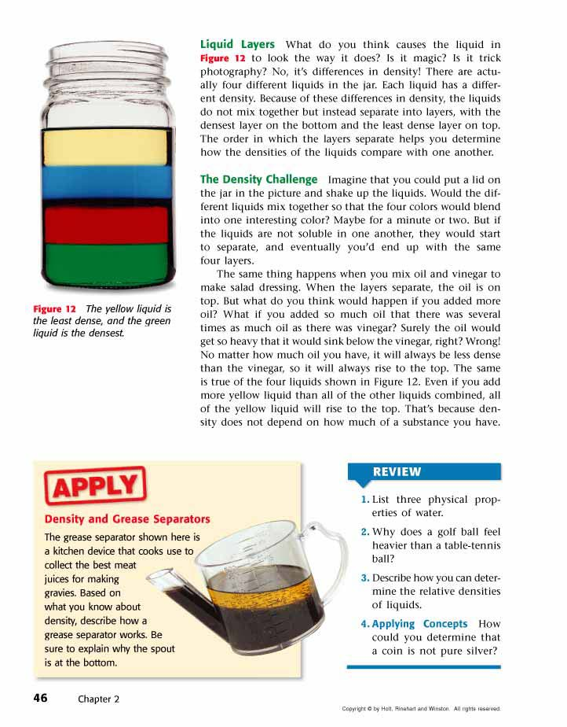
Liquid Layers
Check out this picture. Which layer has the highest density?
Which layer has the lowest density?
Imagine that the liquids have the following densities:
  10g/cm³. 3g/cm³.
  6g/cm³. 5g/cm³.
Which number would go with which layer?
3 g/cm³
5 g/cm³
6 g/cm³
10 g/cm³

Slide 22
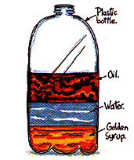
Liquid Layers – Try with your neighbor
Which liquid has the highest density?
Which liquid has the lowest density?
Which liquid has the middle density?

Slide 23
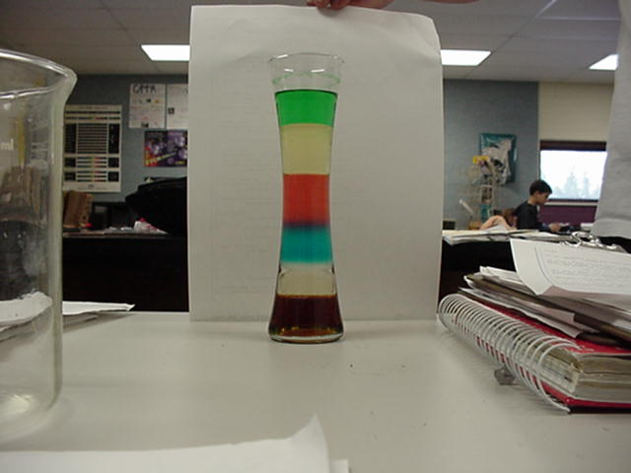
Liquid Layers
Try on your own!
Imagine that the liquids on the right have the following densities:
  15g/cm³ 10g/cm³
  3g/cm³ 9g/cm³
  7g/cm³ 12g/cm³
Match the colors to the correct densities.
3g/cm³
7g/cm³
9g/cm³
10g/cm³
12g/cm³
15g/cm³

Slide 24
Review
What is the formula for density?
What happens if you pour together liquids that have different densities?
Will the liquid on the top have the highest or lowest density?
Will the liquid on the bottom have the highest or lowest density?

Slide 25
Super Scientist
Question of the Day
Jake has a book, a ruler, and a balance.
How can Jake find the density of the book with the tools he has?

Slide 26
http://sunhousescience.blogspot.com/
http://www.icoachmath.com/Sitemap/images/Cuboid1.jpg
http://tinfoiler.com/wp-content/uploads/2010/05/Oil-and-water.jpg
http://www.stevespangler.com/stevespangler/uploads/2008/07/seven-layer-column.png

