Slide 1


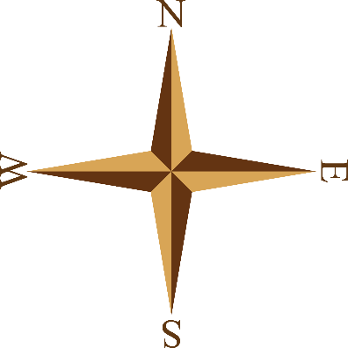

European
Exploration
& Colonization
Portugal, Spain, England, & France

Slide 2
Teachers:
Print out the following slide (one copy for each student). Have the students complete the notes/questions while discussing the presentation.
*The Word document of the following slide is included in this file (in case it prints out blurry).

Slide 3
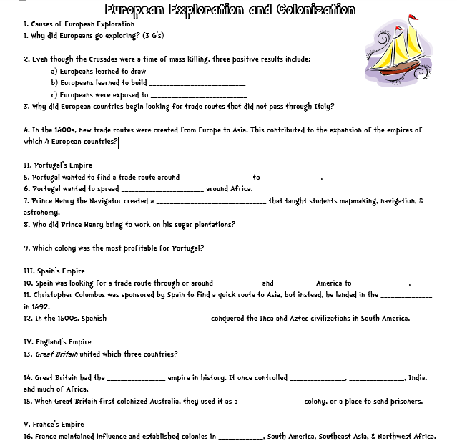

Slide 4
European
Exploration
& Colonization
Portugal, Spain, England, & France

Slide 5

The 3 G’s…
Why did Europeans go exploring?
GOLD
  New trade routes opened up opportunities for wealth.
GOD
  Missionaries wanted to spread Christianity.
GLORY
  Explorers were considered famous heroes; countries competed for colonies.

Slide 6
The Crusades
The Crusades were military expeditions sent by the Catholic Church to capture the Holy Land from the Muslim Turks.
They were not successful, but did have a few positive results:
  Europeans learned to draw better maps and build better ships.
  Exposed Europeans to spices & goods from the East.

Slide 7
Trade Routes
In the 1400s, major trade routes from the East to Europe went through 2 Italian cities (Venice & Genoa).
Italian merchants marked up the prices on the goods & sold them throughout Europe.
Other European countries resented the huge profits made by Italians & began to look for other routes to the East…

Slide 8

Trade Routes
Europeans created new trade routes to bring products from Europe to India, China, & the Spice Islands.
This greatly contributed to the expansion of the empires of Portugal, Spain, England, and France.

Slide 9

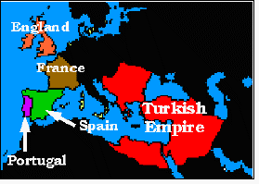

Slide 10
Portugal’s Empire
1n the 15th century , Portugal led the world in sea exploration and explored the western coast of Africa.
The Portuguese wanted to find a trade route around Africa to Asia because:
  They believed they could make a lot of money as traders if they could get Asian goods for a cheaper price.
  They also wanted to spread Christianity along Africa’s west coast.

Slide 11
Prince Henry the Navigator
He was the son of the Portuguese king.
He sent more than 50 expeditions down the west coast of Africa.
  He wanted to establish Portuguese colonies & break the Muslim hold on trade routes.
He also created a naval observatory that taught students navigation, astronomy, & cartography

Slide 12
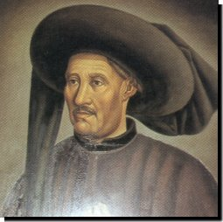
Prince Henry the Navigator

Slide 13
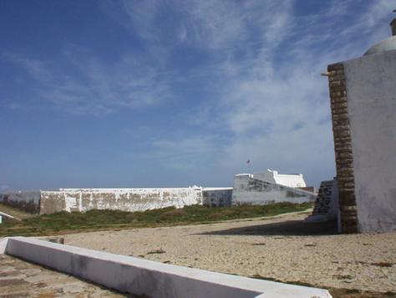
Institute of Sagres

Slide 14
Prince Henry the Navigator
He was unable to make much money trading gold, so he tried creating sugar cane plantations.
  Sugar cane was a very profitable crop, but required lots of labor.
Prince Henry imported slaves from Africa to work the fields.
  This was successful & was later copied in the New World.
  His actions encouraged a slave trade that lasted another 400 years…

Slide 15
Portugal’s Empire
For the next 300 years, Portuguese sailors continued to explore Africa where they established forts & trading posts.
  By 1571, a string of outposts connected Portugal to Africa, India, South Pacific Islands, & Japan
Portugal grew wealthy from these trade routes, but its most profitable colony was Brazil.

Slide 16
Spain’s Empire
Spanish explorers were searching for a trade route through or around North & South America to Asia.
  They wanted to find a quicker route to the gold & spices in Asia.

Slide 17
Christopher Columbus
In the 1490s, Columbus, an Italian, was given ships & sailors by the Spanish monarchy.
  They wanted him to try to find a quick route through the Atlantic Ocean to Asia.
He discovered the Bahamas, but thought he was in Asia.
Later, it was realized that he discovered 2 new continents!
Exploration of these areas brought great wealth to Spain.

Slide 18
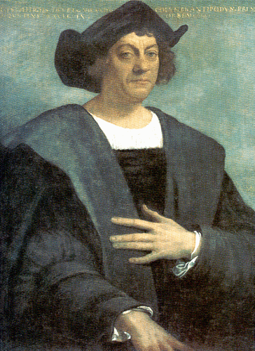
Christopher Columbus

Slide 19
Spain’s Empire
Spain had a huge empire that spanned the globe.
Spanish conquistadors conquered the Inca and Aztec civilizations in the 1500s (South America).
  They were looking for gold & spices.
  They used missionaries to convert natives to Christianity.
Spain claimed huge areas of North & South America & ruled over them for 300 years.

Slide 20
England’s Empire
In the past, England was one of three countries--England, Scotland, & Wales.
In the 1700s, the three united and became Great Britain.
The British empire was the largest in history.
  At its peak, Great Britain controlled: Canada, Australia, India, much of Africa, and numerous islands all over the world.

Slide 21
England’s Empire
North America came under British control in the 1700s.
  It lost the American colonies in 1776, but maintained control over Canada until the 20th century.
Great Britain colonized Australia in 1788.
  It was used as a penal (prison) colony to relieve overcrowded jails in England.

Slide 22
France’s Empire
France possessed colonies around the world from 1600 to 1900.
It also dominated much of the European continent.
  By 1812, France controlled much of Germany and Italy.

Slide 23
France’s Empire
France established other colonies in the 16th-17th centuries:
  --Islands in the Caribbean, the Indian Ocean, the South Pacific, the North Pacific, & the North Atlantic
France also maintained influence in Canada, South America, Southeast Asia, & Northwest Africa.

Slide 24
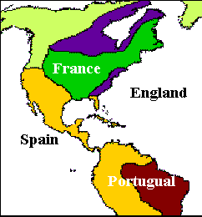

Slide 25
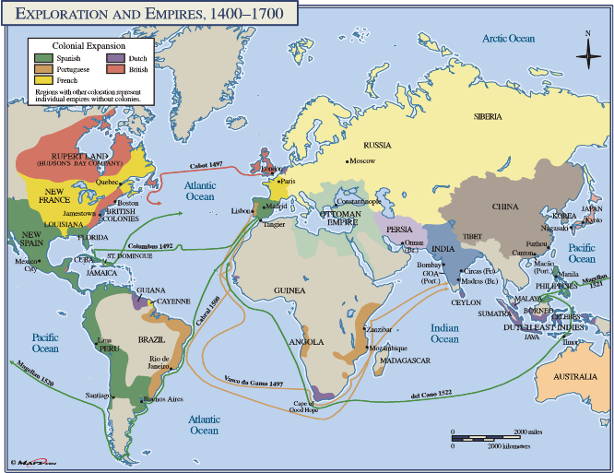

Slide 26
Teachers:
Print out the following slide (there are 2 per page). Have the students color the empires for the European countries based on what they learned in the discussion.

Slide 27
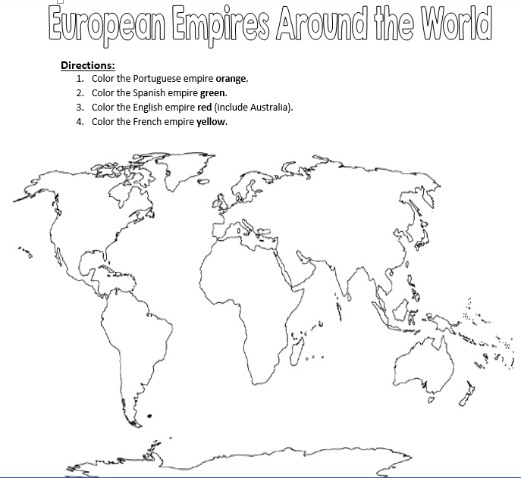

Slide 28
Teachers:
Print out the following slide for each student. Have the students create a “famousbook” page for Prince Henry the Navigator and for Christopher Columbus.

Slide 29
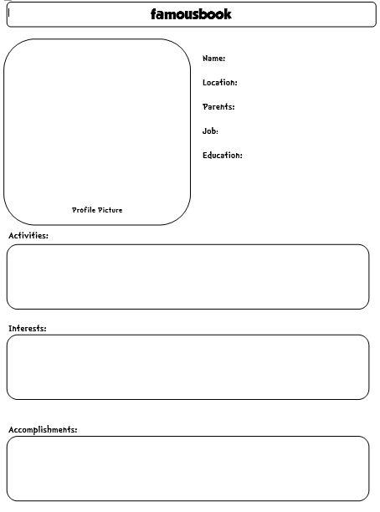

Slide 30
Teachers:
Print out the following slide (there are 2 per page). Have the students complete the graphic organizer as a review of the information learned during the discussion.

Slide 31
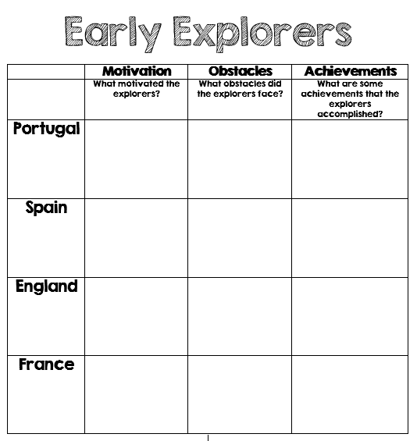

Slide 32
Teachers
Thank you for downloading this file. I hope you enjoy using it with your students, and I can’t wait to read your feedback in my TPT store! ☺
For more social studies materials, please visit my store: http://www.teacherspayteachers.com/Store/Brain-Wrinkles
I teach Language Arts and Social Studies in Georgia, so my products are aligned with Common Core (LA) and Georgia Performance Standards (SS).
*Please note that this product is for single classroom use only.
© Copyright 2013. Brain Wrinkles. All rights reserved. Permission is granted to copy pages specifically designed for student or teacher use by the original purchaser or licensee. The reproduction of any other part of this product is strictly prohibited. Copying any part of this product and placing it on the Internet in any form (even a personal/classroom website) is strictly forbidden. Doing so makes it possible for an Internet search to make the document available on the Internet, free of charge, and is a violation of the Digital Millennium Copyright Act (DMCA).

Slide 33



Credits:
All photos were found via Creative Commons and labeled for reuse.
Fonts:
Backgrounds:

